Slide 1
SE - Lab 1
Introduction into UML and UseCase diagram

Slide 2
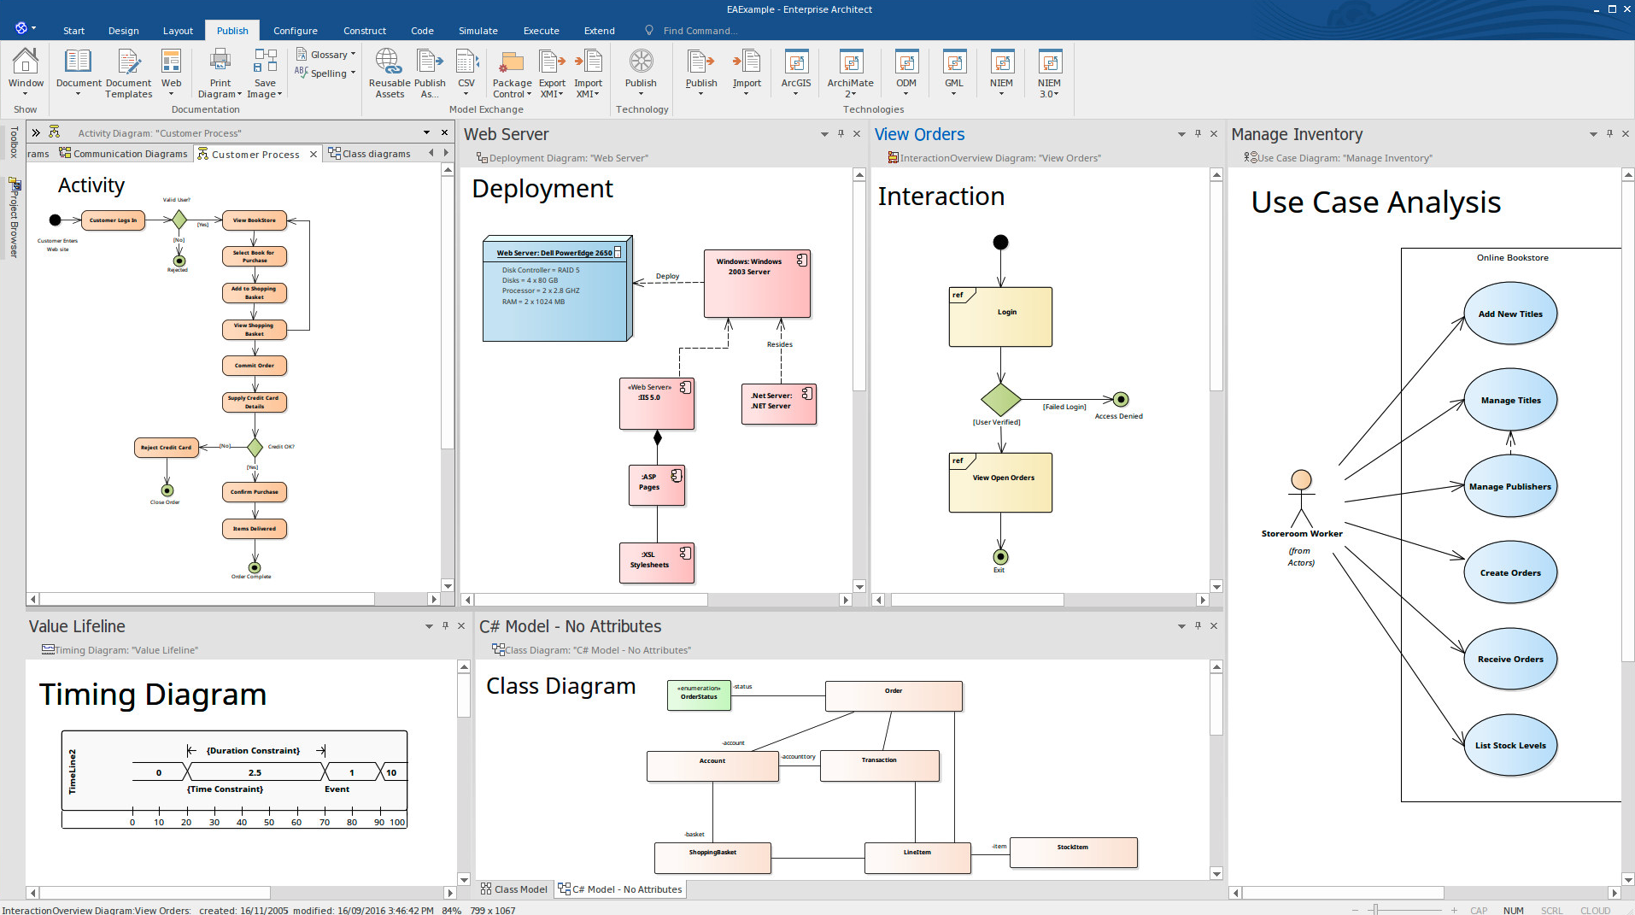
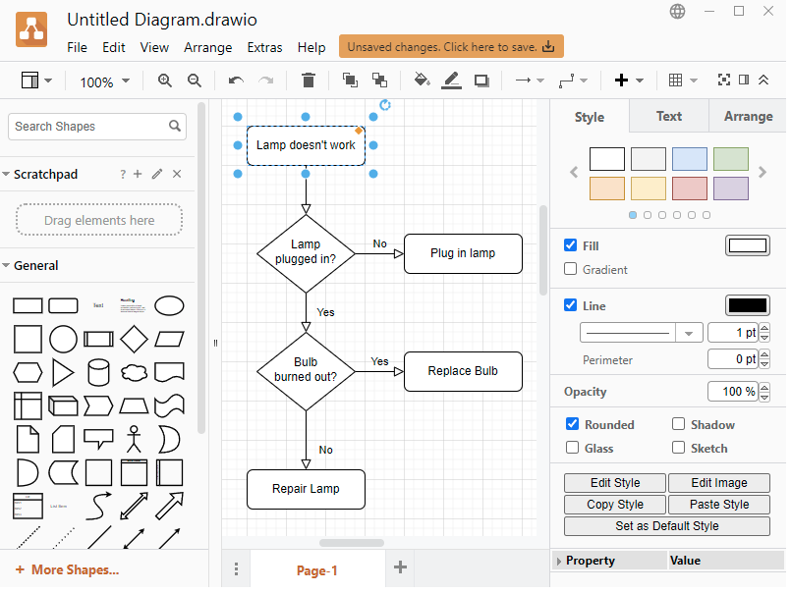
Tools we will use
Enterprise architect
  Commercial SW, we have licence at the University.
Draw.IO
  Free for small project. Ideal for modeling, easy to use, all is located at the browser.

Slide 3
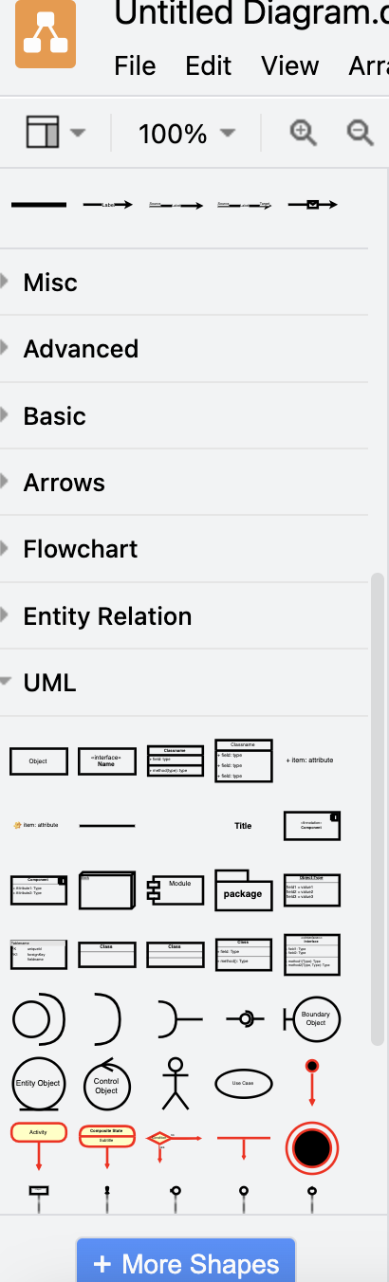
Introduction into tools - Draw.IO
Go to Draw.IO
Login by your Google Account (I suppose all of you have Google account), if not, you must by Enterprise Architect
Select UML located at the left panel
Try to join the UML shapes (don’t solve their meaning, only read them and try to join them)

Slide 4
UML Tools
UseCase diagram
Collaboration Diagram
Domain Model
Class Diagram
State Diagram of the System
Activity Diagram for Describing Transitions Between States

Slide 5
We will follow the Sparx UML tutorial
"The Unified Modeling Language (UML) is a graphical language for visualizing, specifying, constructing, and documenting the artifacts of a software-intensive system. The UML offers a standard way to write a system's blueprints, including conceptual things such as business processes and system functions as well as concrete things such as programming language statements, database schemas, and reusable software components."

Slide 6
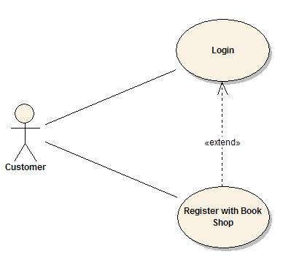
Use Case model
A Use Case Model describes the proposed functionality of a new system. A Use Case represents a discrete unit of interaction between a user (human or machine) and the system. This interaction is a single unit of meaningful work, such as Create Account or View Account Details.
Each Use Case describes the functionality to be built in the proposed system, which can include another Use Case's functionality or extend another Use Case with its own behavior.

Slide 7
Use Case model
A Use Case description will generally includes:
General comments and notes describing the use case.
Requirements - The formal functional requirements of things that a Use Case must provide to the end user, such as <ability to update order>. These correspond to the functional specifications found in structured methodologies, and form a contract that the Use Case performs some action or provides some value to the system.
Constraints - The formal rules and limitations a Use Case operates under, defining what can and cannot be done. These include:
  Pre-conditions that must have already occurred or be in place before the use case is run; for example, <create order> must precede <modify order>
  Post-conditions that must be true once the Use Case is complete; for example, <order is modified and consistent>
  Invariants that must always be true throughout the time the Use Case operates; for example, an order must always have a customer number.
Scenarios – Formal, sequential descriptions of the steps taken to carry out the use case, or the flow of events that occur during a Use Case instance. These can include multiple scenarios, to cater for exceptional circumstances and alternative processing paths. These are usually created in text and correspond to a textual representation of the Sequence Diagram.
Scenario diagrams - Sequence diagrams to depict the workflow; similar to Scenarios but graphically portrayed.
Additional attributes, such as implementation phase, version number, complexity rating, stereotype and status.

Slide 8

Actors
Use Cases are typically related to 'actors', which are human or machine entities that use or interact with the system to perform a piece of meaningful work that helps them to achieve a goal. The set of Use Cases an actor has access to defines their overall role in the system and the scope of their action.

Slide 9
Includes and Extends relationships between Use Cases
One Use Case could include the functionality of another as part of its normal processing. Generally, it is assumed that the included Use Case is called every time the basic path is run. For example, when listing a set of customer orders to choose from before modifying a selected order, the <list orders> Use Case would be included every time the <modify order> Use Case is run.
A Use Case can be included by one or more other Use Cases, so it helps to reduce duplication of functionality by factoring out common behavior into Use Cases that are re-used many times.
One Use Case can extend the behavior of another, typically when exceptional circumstances are encountered. For example, if a user must get approval from some higher authority before modifying a particular type of customer order, then the <get approval> Use Case could optionally extend the regular <modify order> Use Case.

Slide 10
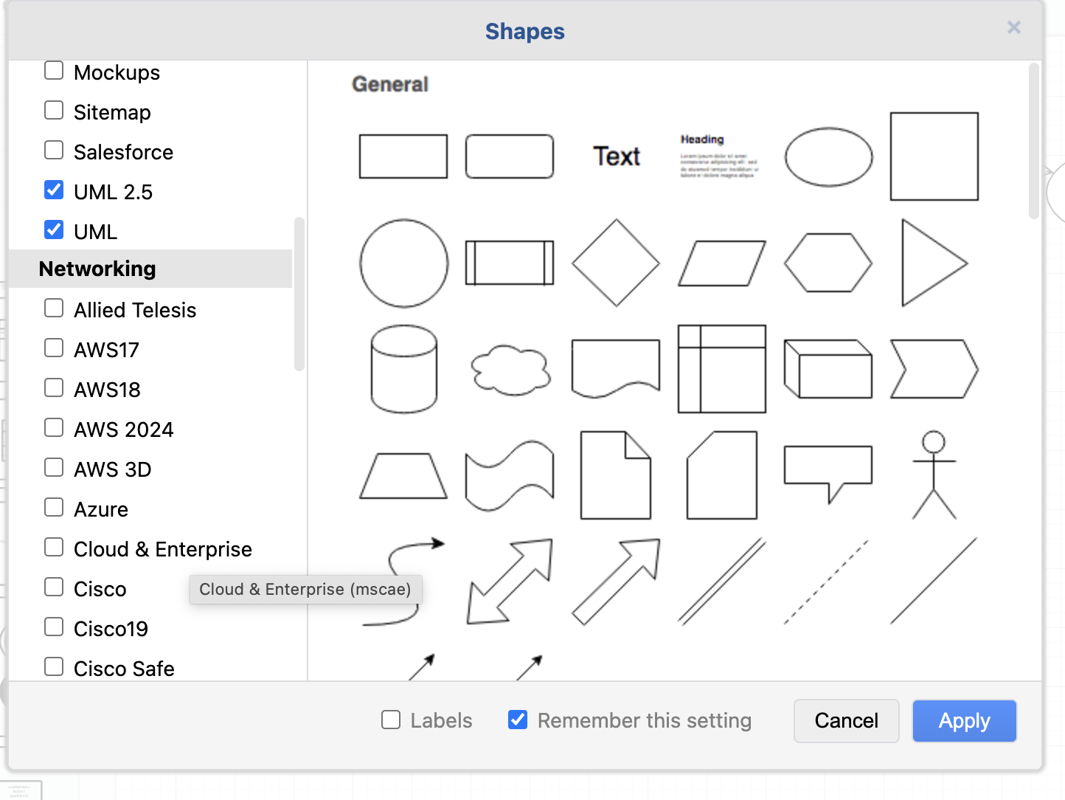
Create your first Use Case diagram
Go To Draw.IO
Open new Diagram (page)
On the Left Panel click More Shapes
Select UML2.x

Slide 11
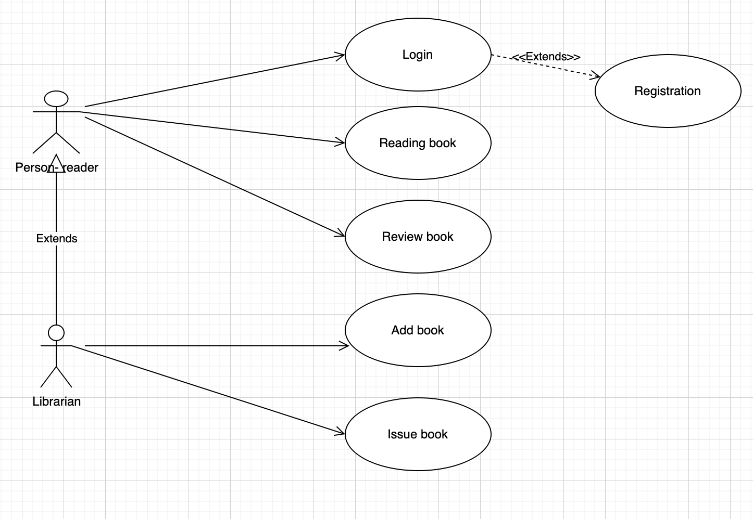
Create your first Use Case diagram
Try to draw the next UseCase diagram
Use shapes from UML2.x
  black pointer has name Association
  dotted line has name Extend
  the line with empty triangle and the end we all Generalization

Slide 12
Exercise 1
Create a Use Case Diagram for a Simple Calculator with Four Basic Mathematical Operations for:
Addition,
Subtraction,
Multiplication,
Division.
The calculator will include:
A field for two numbers,
A field to select the operator,
A button to perform the calculation.

Slide 13
Exercise 2
Create a UML Use Case Diagram for a Currency Calculator application. The calculator will convert entered values between different currencies (e.g., CZK/EUR). The current exchange rate will always be fetched from the internet.
The user will be able to:
Choose the currency to which they want to convert the amount – linked to downloading the exchange rate,
Manually download the exchange rate,
Enter a value to be converted – linked to performing the conversion to another currency.

Slide 14
Make your own model
Present the model to colleagues.

Slide 15
Study Materials
Sparx System UML tutorial: https://sparxsystems.com/resources/tutorials/uml-tutorials.html

